Slide 1
Advanced SQL
Training Seminar
William Bishop
August 17th, 2009

Slide 2
Content
SQL Statement Types
SQL Data Types
Aggregate Functions
NULL
Comparison Operators & Keywords
Set Operations
CASE Statement
Mathematical Operators & Functions
Joins
Subquerys
Views
Materialized Views
Inline Views
Optimizing Select Clauses
Data Sharing
Q&A, Discussion & Problem Solving

Slide 3
SQL (Structured Query Language) is a database computer language designed for managing data in relational database management systems (RDBMS). Its scope includes data query and update, schema creation and modification, and data access control.

Slide 4
SQL Statement Types

Slide 5
SQL Statement Types
DML - stands for Data Manipulation Language, it’s the part of SQL that deals with querying updating and inserting records in tables and views.
DDL – stands for Data Definition Language, it’s the part of SQL that deals with the construction and alteration of database structures like tables, views and the further entities inside these tables like columns. It may be used to set the properties of columns as well.

Slide 6
SQL Statement Types
Examples:
DML
SELECT … FROM … WHERE ….
INSERT INTO …. WHERE …
DELETE FROM …. WHERE …
UPDATE … WHERE ….
DDL
CREATE [TABLE | VIEW | ROLE …
DROP [TABLE | VIEW | ROLE …
GRANT …. TO …. ON …
ALTER [TABLE | COLUMN …

Slide 7
SQL Data Types

Slide 8
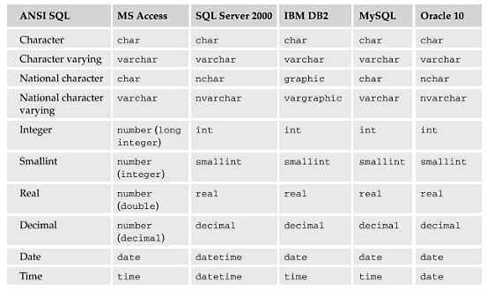
SQL Data Types

Slide 9
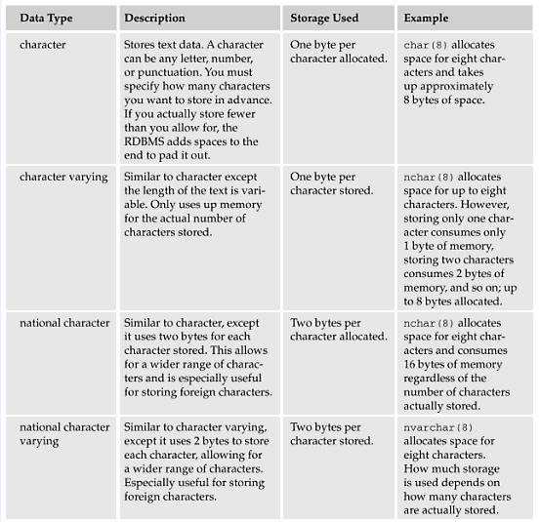
SQL Data Types (Descriptions)

Slide 10
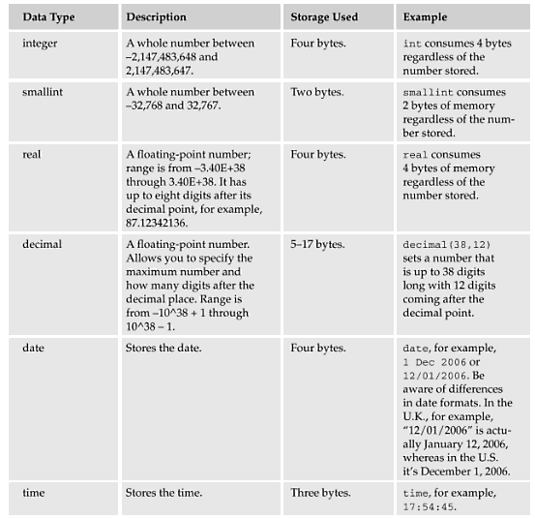
SQL Data Types (Descriptions)

Slide 11
Aggregate Functions

Slide 12
Aggregate Functions assist with the summarization of large volumes of data. They return a single result row based on groups of rows, rather than on single rows. Aggregate functions can appear in select lists and in ORDER BY and HAVING clauses.

Slide 13
Aggregate Functions
Function | Access | SQL Server | MySQL | SQL Server | Oracle
Sum | SUM | SUM | SUM | SUM | SUM
Average | AVG | AVG | AVG | AVG | AVG
Count | COUNT | COUNT | COUNT | COUNT, COUNT_BIG* | COUNT COUNT(*)
Standard Deviation | STDEV | STDEV | STD, STDEV | STDEVP, VAR, VARP | STDEV, STDEV_POP, STDEV_SAMP
Minimum | MIN | MIN | MIN | MIN | MIN
Maximum | MAX | MAX | MAX | MAX | MAX
Others |  |  |  | CHECKSUM, CHECKSUM_AGG BINARY_CHECKSUM | MEDDAN, LAST, GROUPING

Slide 14
Aggregate Functions
Effect of NULL on aggregate function output
  No effect, NULL values are eliminated from the result set.
  Except for the COUNT function, NULL values are grouped and returned as part of the result set.
Use GROUP BY when using aggregate functions in a multiple column in a select statement
Use HAVING when using aggregate functions are referred to in the condition.

Slide 15
Aggregate Functions
  SELECT state, count(*)
  FROM test
  WHERE state IN(‘CA’,’LA’)
  GROUP BY state
  ORDER BY state
  SELECT state, count(*)
  FROM test
  GROUP BY state
  HAVING state IN(‘CA’,’LA’)
  ORDER BY state
Which is better??
WHERE CLAUSE restricts the number of rows that are counted
HAVING is applied to the result set last after all rows are counted.

Slide 16
Aggregate Functions
  SELECT state, SUM(baldue)
  FROM test
  WHERE state IN(‘CA’,’LA’)
  GROUP BY state
  ORDER BY state
  State Sum(baldue)
  ===== ===========
  CA 250.00
  CO 58.75
  GA 3987.50
  LA 0.0
  MN 510.00
  NY 589.50
  TX 62.00
  VT 439.00
  SELECT state, SUM(baldue)
  FROM test
  WHERE state IN(‘CA’,’LA’)
  GROUP BY state
  HAVING SUM(baldue) > 0
  ORDER BY state
  State Sum(baldue)
  ===== ===========
  CA 250.00

Slide 17
NULL

Slide 18
NULL
What is it??
NULL is not a data value
Indicates the absence of data
Using NULL in any equation yields NULL as the result.
Must modify NULL via a function to produce non null result.
      NULLIF() - SQL Server, MySQL
      NVL() - Oracle
      CASE statement
Checking for NULL
      ISNULL() - SQL Server, MySQL
      IFNULL() – MySQL
Notes:
Select NULL + 1 FROM dual
vs
Select NVL(NULL,0) + 1 FROM dual

Slide 19
Comparison Operators & Keywords

Slide 20
Comparison Operators & Keywords
Operators
Keywords
  LIKE
  BETWEEN, IN
  EXISTS
=, !=*, <, >, <=, >= | Oracle *not ISO standard
>, <, >=, <>, !=*, !<*, !>* | T-SQL *not ISO standard
=, >, <, >=, <>, !=*, !<*, !>*, -=*, ->*, -<* | T-SQL *not ISO standard
Notes:
SELECT …
FROM …
WHERE … LIKE (%...)
SELECT …
FROM …
WHERE IN (… ,… ,…) OR
SELECT …
FROM …
WHERE EXISTS (SELECT …
FROM …
WHERE …)
SELECT …
FROM …
WHERE IN (SELECT …
FROM …
WHERE …)

Slide 21
Comparison Operators & Keywords
Precedence
  Operators with higher precedence are applied first
  When operators have the same precedence they are handled differently depending on the db.
    Oracle – applied in no particular order
    SQL Server – applied in left to right order
  Parenthesis can be used the control the order of precedence.
    Evaluation is done from innermost set to outer when nested.
Notes:
SELECT …
FROM …
WHERE … LIKE (%...)
SELECT …
FROM …
WHERE IN (… ,… ,…) OR
SELECT …
FROM …
WHERE EXISTS (SELECT …
FROM …
WHERE …)
SELECT …
FROM …
WHERE IN (SELECT …
FROM …
WHERE …)

Slide 22
Set Operations

Slide 23
Set Operations let you combine rows from different sets, locate which rows exist in both sets, or find which rows exist in one set but not the other.

Slide 24
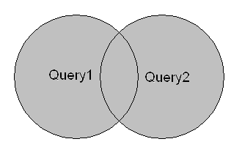
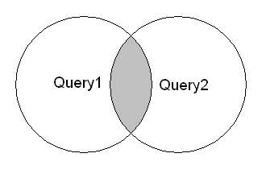
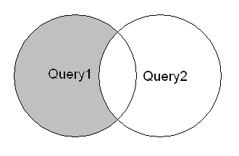
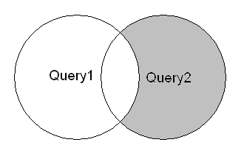
Set Operations
UNION [DISTINCT | ALL]
  SELECT … FROM …. WHERE …
  UNION
  SELECT … FROM … WHERE …
INTERSECT [DISTINCT | ALL]
  SELECT … FROM …. WHERE …
  INTERSECT
  SELECT … FROM … WHERE …
EXCEPT [DISTINCT | ALL]
  SELECT … FROM …. WHERE …
  EXCEPT
  SELECT … FROM … WHERE …
Notes:
Keywords ALL and DISTINCT can be used depending on the language to modify set operators to return either the entire result set (ie: duplicates) by specifying ALL or or to exclude the duplicates by specifying DISTINCT.
The SQL standard does not enforce keyword Distinct and some DBMSs for example Oracle and SQL Server do not even allow it, therefore if you see just Union, Except or Intersect - these actually mean Union Distinct, Except Distinct and Intersect Distinct.
Facts to remember:
Column count must be the same;
Data types of retrieved columns should match or at least should be implicitly convertible by database;
Usually returned column names are taken from the first query;
Order by clauses for each individual query except the last one cannot be there at all as is the case with Oracle or are ignored in MySQL.

Slide 25
Set Operators
Multiple select statements can be combined using different set operators in the same statement.
    SELECT … FROM …. WHERE …
    INTERSECT
    SELECT … FROM … WHERE …
    UNION
    SELECT … FROM … WHERE …
Notes:
Facts to remember:
Check DB documentation for the order of operators, because for example Oracle executes operators starting from left to right, but DB2 executes Intersect operators first;

Slide 26
Set Operators
In a UNION both statements must have same number of columns.
NULL values are considered equal.
Precedence
  Operators with higher precedence are applied first
  When operators have the same precedence they are handled differently depending on the db.
    Oracle – applied in no particular order
    SQL Server – applied in left to right order
  Parenthesis, (), can be used the control the order of precedence.
    Evaluation is done from innermost set to outer when nested.
Notes:
SELECT …
FROM …
WHERE … LIKE (%...)
SELECT …
FROM …
WHERE IN (… ,… ,…) OR
SELECT …
FROM …
WHERE EXISTS (SELECT …
FROM …
WHERE …)
SELECT …
FROM …
WHERE IN (SELECT …
FROM …
WHERE …)

Slide 27
CASE Statement

Slide 28
CASE Statement
  SELECT
    (CASE <expression>
      WHEN <value1> THEN <result1>
      WHEN <value2> THEN <result2>
      …
      WHEN <valueN> THEN <resultN>
      [ ELSE <else-result> ]
    END)
  FROM …
  WHERE …

Slide 29
CASE Statement
Used to provide if-then-else type logic to SQL
Uses two types case expressions; simple and search
    Simple expressions provides only an equality check
    Search expressions allows the use of comparison operators (AND, OR) between each boolean expression.
Can be used in queries or sub queries
Notes:
SELECT last_name, commission_pct,
(CASE commission_pct
WHEN 0.1 THEN ‘Low’
WHEN 0.15 THEN ‘Average’
WHEN 0.2 THEN ‘High’
ELSE ‘N/A’
END ) Commission
FROM employees
ORDER BY last_name;
SELECT last_name, job_id, salary,
(CASE
WHEN job_id LIKE 'SA_MAN' AND salary < 12000 THEN '10%'
WHEN job_id LIKE 'SA_MAN' AND salary >= 12000 THEN '15%'
WHEN job_id LIKE 'IT_PROG' AND salary < 9000 THEN '8%'
WHEN job_id LIKE 'IT_PROG' AND salary >= 9000 THEN '12%'
ELSE 'NOT APPLICABLE'
END ) Raise
FROM employees;

Slide 30
Mathematical Operators & Functions

Slide 31
Mathematical Operators & Functions
Operators (Division, Subtraction, Multiplication, Addition)
  Operators with higher precedence are applied first
    Multiply, Divide and Modulo have higher precedence than Addition and Subtraction
  Operators with the same precedence are handled differently depending on the db.
    Oracle – applied in no particular order
    SQL Server – applied in left to right order
  Parenthesis, (), are used to control the order of precedence.
    Evaluation is done from innermost set to outer when nested.

Slide 32
Mathematical Operators & Functions
Functions
  absolute value [ABS]
  rounding [ROUND]
  square root [SQRT]
  sign values [SIGN]
  ceiling [CEIL] and floor [FLOOR]
  exponential value [SIN,COS,TAN]
Can be used in most SQL statements (select, update, etc)

Slide 33
Joins

Slide 34
Joins are one of the basic constructions of SQL and Databases and as such they combine records from two or more database tables into one set of rows with the same source columns. These columns can originate from either of the joined tables as well as be formed using expressions and built-in or user-defined functions.

Slide 35
Join Types
INNER
    Only rows satisfying selection criteria from both joined tables are returned.
OUTER
    Left - remaining row from the left joined table are returned along with nulls instead of actual right hand joined table rows.
    Right - remaining row from the right joined table are returned along with nulls instead of actual left hand joined table rows.
    Full – remaining rows from both right and left table are returned.
SELF
    Single table is joined to itself; the second table is same as the first but renamed using an alias.
CROSS (cartesian product)*
    All rows are returned from both tables, no condition is specified, or the condition is always true.

Slide 36
Joins Syntax
Cross Join:
  SELECT <column list>
  FROM <left joined table>, <right joined table>
Inner Join:
  SELECT <column list>
  FROM <left joined table>, <right joined table>
  WHERE <join condition>
  SELECT <column list>
  FROM <left joined table>
  [INNER] JOIN <right joined table>
  ON <join condition>

Slide 37
Joins Syntax
Outer Join:
  SELECT <column list>
  FROM <left joined table>, <right joined table>
  WHERE <join condition>
  SELECT <column list>
  FROM <left joined table>
  LEFT | RIGHT | FULL [OUTER] JOIN <right joined table>
  ON <join condition>

Slide 38
Joins Syntax
Outer Join (Oracle):
  SELECT <column list>
  FROM <left joined table>, <right joined table>
  WHERE <left joined column> (+) = <right joined table column>
Outer Join (DB2):
  SELECT <column list>
  FROM <left joined table>, <right joined table>
  WHERE <left joined column> #= <right joined table column>

Slide 39
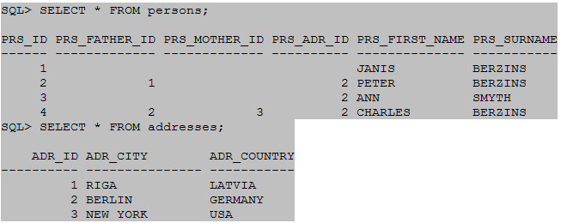
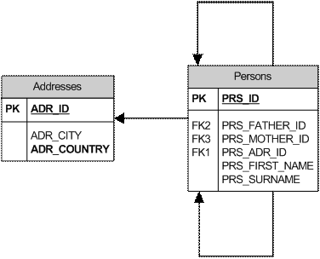
Joins – Example (Data)

Slide 40
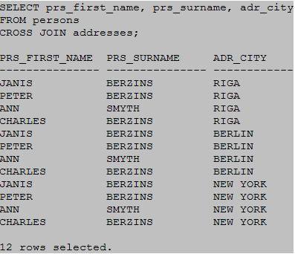
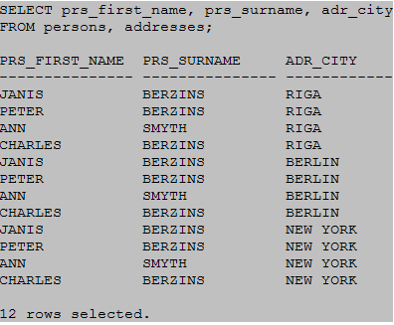
Cross Join – Examples
Notes:
Facts to remember
Usually cross joins are used quite rarely; some of the scenarios could be as follows:
Possibility to generate high amount of rows. As we can see from relatively small tables there is possibility to get quite monstrous numbers.
Find out all possible row combinations of some tables. Mostly this is useful for reports where one needs to generate all combinations for example all nationalities x genders for persons.
To join a table with just one row. Most often used to get some configuration parameters.

Slide 41
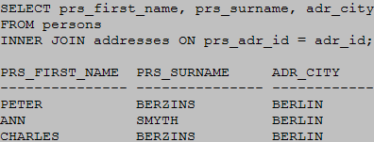
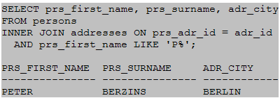
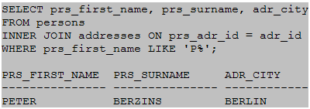
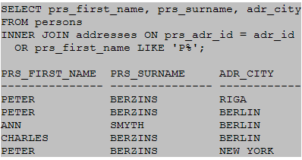
Inner Join - Examples
Notes:
Facts to remember:
All following facts are relevant to almost every join type, however the inner join is the most common join type.
Databases are designed to do joins efficiently. Not client, not middle tier, but databases. Creating data model usually normalization is being done mostly to avoid data duplication. To show data in person-readable form, joining is one of the necessary prerequisites. Inner join is one of the most common join types and it should be done in database. Database means efficiently in the place where data resides and not in client/middle tier cycling through (possibly) many cycles.
It should be noted that other clauses for SQL statements e.g. GROUP BY, HAVING, ORDER BY are of course usable for SQL statements with joins.
One must be cautious using join conditions with columns without NOT NULL constraint. Comparing NULL values with different explicit values or even Nulls is probably a bit counter-intuitive on the first sight.
The position of additional conditions is irrelevant for INNER joins. These can be written both as join condition and in WHERE clause, result is the same.
For Inner join it is not relevant, which table is first one and which second one.

Slide 42
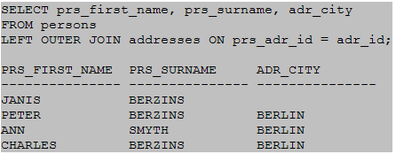
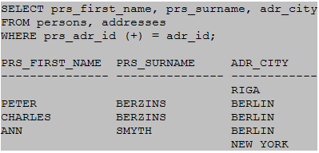
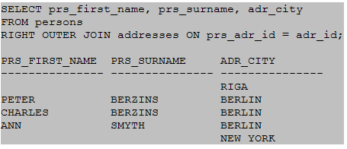
Outer Joins - Examples
Notes:
Facts to remember:
Outer joins should be used only when necessary. If it is possible (data model and business data allows) inner join should be used. Inner join offers greater flexibility for optimizer and doesn't mislead people to the thoughts that some rows of one cannot be joined to other table.
Unlike Inner joins it is important where the condition is written - either as join condition or in WHERE clause.
Not all Database management systems support Full outer joins. Use a (the set operator) UNION of Left and Right joins to simulate a FULL outer join.
Oracle (MySQL) outer join operator has more restrictions than more modern ANSI syntax, for example:
It doesn't support Full Outer join;
It cannot be used together with modern syntax;
Join condition cannot contain logical OR and IN operators.

Slide 43
Subqueries

Slide 44
Subqueries are queries that are nested inside a SELECT, INSERT, UPDATE or DELETE statement, or inside of another subquery. A subquery can be used anywhere an expression is allowed .

Slide 45
Subqueries
A subquery must be enclosed in the parenthesis.
A subquery must be put in the right hand of the comparison operator
A subquery cannot contain a ORDER-BY clause.
A query can contain more than one sub-queries.

Slide 46
Subqueries
3 Subquery Types
    Single-row subquery - where the subquery returns only one row.
    Multiple-row subquery - where the subquery returns multiple rows.
    Multiple column subquery - where the subquery returns multiple columns.
Another name for these query types is:
Correlated Subquery.

Slide 47
Subqueries
Correlated Subqueries
  Are dependent on the their outer query*
  Will be executed many times while it’s outer queries is being processed, running once for each row selected by the outer query.
  Can be in the HAVING OR WHERE clauses

Slide 48
Subqueries
SELECT store_name,
sum(quantity)
store_sales,
(SELECT sum(quantity)
FROM sales)/
(SELECT count(*)
FROM store) avg_sales
FROM store s, sales sl
WHERE s.store_key = sl.store_key
HAVING sum(quantity) > (SELECT sum(quantity) from sales)/(select count(*)
FROM store)
GROUP BY store_name;

Slide 49
Views

Slide 50
Views
A view is a virtual table based on the result-set of a SQL statement
Views contain rows and columns, just like a real table. The fields in a view are fields from one or more real tables in the database.
Views (virtual) always show up-to-date data. The db engine recreates the data using the view’s SQL statement every time a user queries the view.

Slide 51
Views
Why create views??
  Hide data complexity
  Security
  Save space
Read-only vs. Update
  Usually only a single table can be updated (for inherently updateable views).
  For multi-table views usually the tables whose unique index is accessed in the view can be updated.
  For some DBs only one table in the view may be updated.
  INSTEAD OF database triggers can be created on any view to make updatable.
Notes:
If the database system can determine the reverse mapping from the view schema to the schema of the underlying base tables, then the view is updatable. Insert, update and delete operations can be performed on updatable views.
Notes on Updatable Views
An updatable view is one you can use to insert, update, or delete base table rows. You can create a view to be inherently updatable, or you can create an INSTEAD OF trigger on any view to make it updatable.
To learn whether and in what ways the columns of an inherently updatable view can be modified, query the USER_UPDATABLE_COLUMNS data dictionary view. The information displayed by this view is meaningful only for inherently updatable views. For a view to be inherently updatable, the following conditions must be met:
Each column in the view must map to a column of a single table. For example, if a view column maps to the output of a TABLE clause (an unnested collection), then the view is not inherently updatable.
The view must not contain any of the following constructs:
A set operator
a DISTINCT operator
An aggregate or analytic function
A GROUP BY, ORDER BY, MODEL, CONNECT BY, or START WITH clause
A collection expression in a SELECT list
A subquery in a SELECT list
A subquery designated WITH READ ONLY
Joins, with some exceptions, as documented in Oracle Database Administrator's Guide
In addition, if an inherently updatable view contains pseudocolumns or expressions, then you cannot update base table rows with an UPDATE statement that refers to any of these pseudocolumns or expressions.

Slide 52
View Syntax
Create
    CREATE VIEW <view name> AS
    SELECT <column list>
    FROM <table list>
    WHERE expression
Update
    CREATE OR
    REPLACE VIEW <view name> AS
    SELECT <column list>
    FROM <table list>
    WHERE expression
Drop
    DROP VIEW <view name>
Notes:
If you want a join view to be updatable, then all of the following conditions must be true:
1. The DML statement must affect only one table underlying the join.
2. For an INSERT statement, the view must not be created WITH CHECK OPTION, and all columns into which values are inserted must come from a key-preserved table. A key-preserved table is one for which every primary key or unique key value in the base table is also unique in the join view.
3. For an UPDATE statement, all columns updated must be extracted from a key-preserved table. If the view was created WITH CHECK OPTION, then join columns and columns taken from tables that are referenced more than once in the view must be shielded from UPDATE.
For a DELETE statement, if the join results in more than one key-preserved table, then Oracle Database deletes from the first table named in the FROM clause, whether or not the view was created WITH CHECK OPTION.

Slide 53
View Syntax (Updatable Views)
INSTEAD OF Triggers Syntax
  CREATE OR REPLACE TRIGGER <trigger name>
  INSTEAD OF < INSERT | UPDATE | DELETE >
  FOR EACH ROW
  BEGIN
  …
  END <trigger name>

Slide 54
View Syntax (Updatable Views)
INSTEAD OF Triggers Example
  CREATE OR REPLACE TRIGGER ioft_emp_perm
  INSTEAD OF DELETE
  ON employee_permission_view
  FOR EACH ROW
  BEGIN
  DELETE FROM dept_code
  WHERE dept_code = :OLD.dept_code;
  UPDATE employee
  SET dept_code = NULL,
  mod_user_id = USER,
  mod_user_date = SYSDATE
  WHERE dept_code = :OLD.dept_code;
  DELETE FROM test
  WHERE test = 'Z';
  END ioft_emp_perm;

Slide 55
Materialized Views

Slide 56
Materialized Views are created in the same way that ordinary views are created from a query. The resulting data set is cached and can be updated from the original database tables.

Slide 57
Materialized Views
Why use Materialized Views??
  Data warehousing.
    Stage tables, summarization (pre-calculation)
  More efficient access than ordinary views.
  Have all the advantages of database tables.
Names (depending on DB)
  Materialized View (Oracle)
  Materialized Query (DB2).
  Indexed Views (SQL Server).
  Flexviews (MySQL).

Slide 58
Materialized Views
Types of Materialized Views
Read only
  Cannot be updated
Updatable
  Can be update even when disconnected from the master site
  Are refreshed on demand
  Consume fewer resources
Writable
  Created with the FOR UPDATE clause
  Changes are lost when view is refreshed

Slide 59
Materialized Views - Syntax
ORACLE:
CREATE MATERIALIZED VIEW <name>
TABLESPACE <tablespace>
BUILD <IMMEDIATE | DEFERRED>
AS
SELECT … ;
DB2:
CREATE TABLE <name> AS (
SELECT …
)
[INITIALLY DEFERRED]
REFRESH DEFERRED
IN <tablespace> INDEXES IN <tablespace>;

Slide 60
Materialized Views - Syntax
SQL SERVER:
CREATE VIEW <name>
WITH SCHEMABINDING
AS
SELECT … ;

Slide 61
Inline Views

Slide 62
Inline Views are select statements in the FROM-clause of another select statement. In-line views are commonly used to simplify queries by removing join operations and condensing several separate queries into a single query.

Slide 63
Inline Views
Act as tables in select statements
Can be columns in some DBs (SQL Server, Oracle)
Known as Nested Subqueries in DB2
Cannot be indexed

Slide 64
Inline Views - Examples
Inline View as Table:
SELECT s.first_name
FROM employee s
INNER JOIN (SELECT ID
FROM title
WHERE job_title = 'tester') d
ON s.ID = d.ID;
…OR…
SELECT s.first_name
FROM employee s,
(SELECT ID
FROM title
WHERE job_title = 'tester') d
WHERE s.ID = d.ID;

Slide 65
Inline Views - Examples
Inline View as Column:
SELECT cu CompanyName,
(SELECT MIN(OrderDate)
FROM Orders o
WHERE o.CustomerID = cu.CustomerID)
AS OrderDate
FROM Customers cu;

Slide 66
Optimizing Select Clauses

Slide 67
Optimizing Select Clauses
Why??
  Performance improvement
Order of listed tables and views
  Search largest tables as few times as possible
Use of functions (or not)
  Avoid using functions in the where clause
Use of database hints/options (Oracle vs. SQL Server)
  Index selection
  Search (join) type
  Order of tables in join

Slide 68
Data Sharing

Slide 69
Data Sharing
Global Variables (DB2*, Oracle)
DB2 Connect
Database PIPES (Oracle, DB2)
SQL Data Services (db-as-a-service) “aka db in a cloud”
(http://www.azurejournal.com/2009/05/sql-data-services-your-database-in-the-cloud/)

Slide 70
Q&A, Discussion and Problem Solving

